Slide 1
Neural Gene Transfection
An Introduction

Slide 2
What is Gene Transfection?
Generation of genetically modified animals
Genetic modification of germ cells
Breeding modified individuals
To combine gene cutting or expression tools
Acute modulation of Gene Expression
Requires transfection / transduction

Slide 3
What is Gene Transfection?
Moving exogenous DNA
Including gene sequences
Usually coding for proteins
into Living Cells
in order to modify cellular Gene Transcription
to thereby modify Cell Function

Slide 4
Cellular Transfection
Nucleic Acids can not
diffuse through lipophilic cell membranes
Also true for some drugs
Due to hydrophilic or charge properties
Chemical facilitation
Physical stimulation
May increase efficiency

Slide 5
Cellular Transfection
Cell culture – in vitro
First successful gene transfer – 1976-78
Reveals much about cell function
What genes are not normally active in these cells
Each type of cell is unique
relative to gene expression
How to increase/inhibit gene expression
Visualizing transfected cells

Slide 6
Cellular Transfection
In vivo – elucidating system function
with in situ cellular communication maintained
Biochemical milieu is normal - complete
Systemic delivery
Circulating nucleic acids have short half-life
Direct injection
Still requires help to cross plasma membrane

Slide 7
Neural Transfection
Systemic Delivery
Blood-Brain-Barrier (BBB)
Isolates brain from cranial vasculature
Glial tight-junctions surrounding vasculature
Short ½–life protection needed
Indiscriminant delivery to all brain regions
Expression may be modified by promoter tools

Slide 8
Neural Transfection in vivo
Direct Injection into specific Brain Regions
Bypassing BBB
Targeting Neuronal subtypes
Even within a region
Glutamate, GABA, Monoamine, Neuropeptide
May elucidate neurocircuit function

Slide 9
Methods for Neural Transfection
Chemically mediated transfection
External carriers with specific chemical properties
Physical enhancement of DNA movement
Reversible alterations in plasma membrane
or endocytosis
Virally mediated transduction
Intrinsic transfection ability of viruses

Slide 10
Chemically Mediated Transfection
Formation of Complexes with nucleic acids
Good gene packaging, low toxicity
Low efficiency

Slide 11
Chemically Mediated Transfection
Lipids (lipofection)
hydrophilic domain + lipophilic tail
Nanoparticles
High stability & protection
Polymers
Macromolecules of repeated units

Slide 12
Lipid Mediated Transfection
Lipoplex – DNA + hydrophilic domain
Lipid vectors suffer from short ½-life
Rapid degradation from phagocytes
Cationic lipid protects DNA
From cleavage by endonucleases
In circulation

Slide 13
Lipid Mediated Transfection
added Protection and Stabilization
Polyethylene glycol (PEG)
Pegolation
1,2 dioleoylphosphatidyl-ethanolamine
DoPE

Slide 14
Lipid Mediated Transfection
PEG or DoPE
Increases fusion with cell membrane
Endosome lipocomplex
Facilitates movement of DNA
between endosomes & cell nucleus
influence 3º structure of lipoplex

Slide 15
Lipid Mediated Transfection
Nanoemulsions (LNEs)
Dispersion of nanoparticles of lipids
Liquid phase due to surfactant
Higher efficiency than liposomes
in vitro or in vivo delivery

Slide 16
Lipid Mediated Transfection
Solid Lipid Nanoparticles (SLNs)
Lipid nanospheres
Outer hydrophilic shell - lipid bilayer
Inner core – long-chained lipids
Solid and Stable at body Tº
May cross the BBB

Slide 17
Lipid Mediated Transfection
Efficient in vivo gene transfection
By intracranial (ic)
intracerebroventricular (icv)
or intranasal (in) delivery

Slide 18
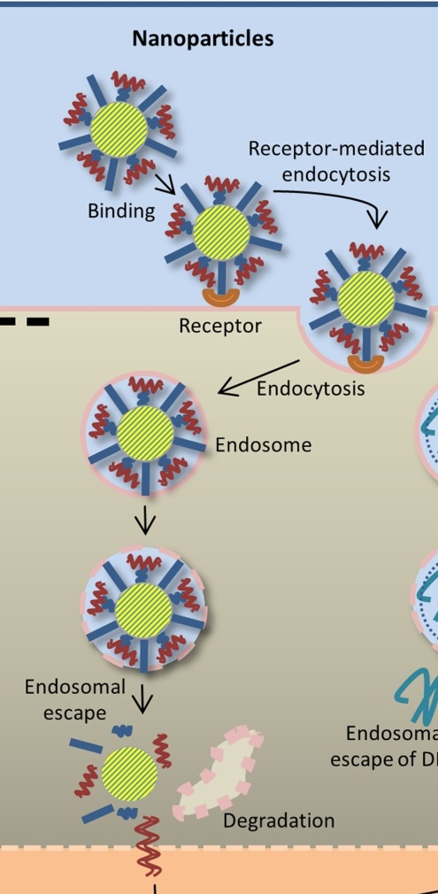
Nanoparticles & Transfection
High stability
Gold nanoparticles
Silica nanoparticles
Fullerenes
Polymers
Many others

Slide 19
Gold assisted Transfection
Coated with cationic molecules
Bind nucleic acids & endocytosis
Efficient delivery of DNA
Very low toxicity
Cross the BBB – enhanced by PEG etc
Optical properties – region localization

Slide 20
Silica Transfection
Oxide of silicon
Coated with organic amino acids
Interact with nucleic acids
Protect from endonucleases
Phagocytosis internalization
Neuroinflammation after intranasal

Slide 21
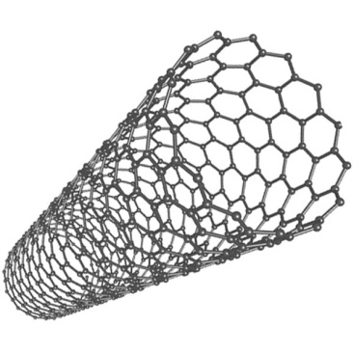
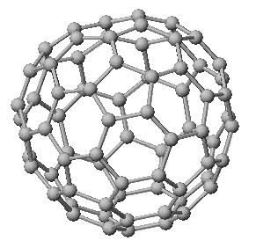
Transfection by Fullerenes
Bucky Balls
Spherical (SF) Cylindrical nanotubes (CNTs)
Cationic charges – stable 2x DNA
Protective against nucleases
SFs can cross BBB
CNTs poorly soluble in water
cross plasma membrane - functionalized with peptides and conjugated to DNA

Slide 22
Polymer nanoparticles
PEI = polyethylenimine
Chitosans
TMC = trimethylated chitosan
Dendrimers
PAMAM = polyamidoamine

Slide 23
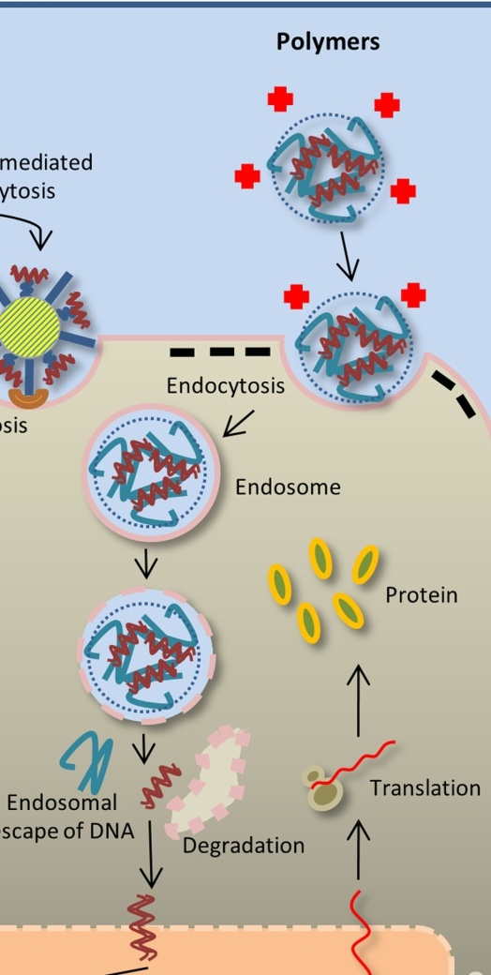
Polymer mediated Transfection
Positively charged surface
Interacts with negative DNA
Can be pegolated
Can be modified by peptides

Slide 24
Physical Enhancement
Electroporation
Creates temporary H₂0-filled holes in membrane
application of electric-field pulses
Sonoporation
Ultrasound stimulated temporary pores
Magnetic-assisted Transfection
Directs magnetic nanoparticles containing DNA

Slide 25
Physical Enhancement

Slide 26
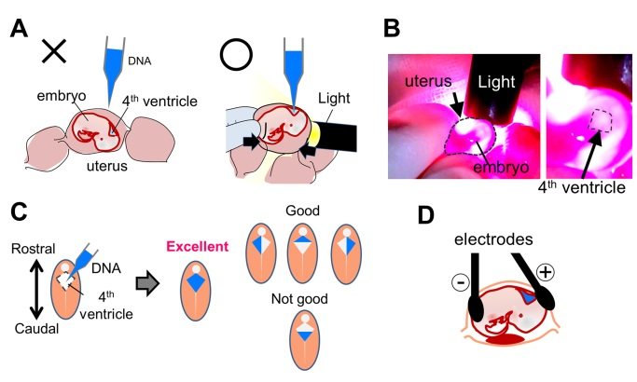
Physical Enhancement
Electroporation
Mostly used in vitro
Used in vivo and ex vivo on embryos
Sonoporation
+ microbubbles increases efficiency
Magnetic-assisted Transfection
Directs magnetic nanoparticles containing DNA

Slide 27
Physical Enhancement
Electroporation
Mostly used in vitro
Used in utero and exo utero on embryos

Slide 28
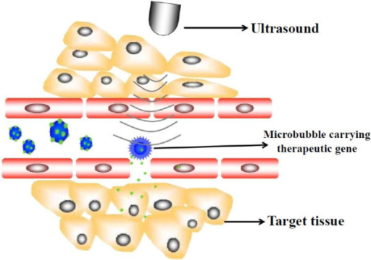
Sonoporation Enhancement
Mostly in vitro
Bubbles may
contain cationic
lipids to bind DNA
Mostly in vitro
Low efficiency

Slide 29
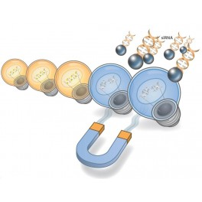
Magnetofection
Magnetic Nanoparticles (MNPs)
MNPs contain iron oxide (Fe₂O₃, FeO, Fe₃O₄)
core + additional organic or inorganic coating
liposomal, polymers, peptides, ligands + receptors
Binds DNA well
Endocytosis leaves membrane intact
Simple and highly efficient – still mostly untried

Slide 30
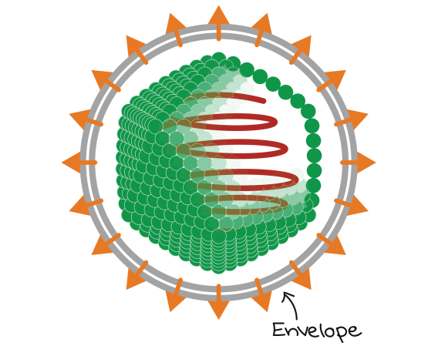
Virally Mediated Transduction
Nanometric infective agents
Protein Capsid
Protects Genetic Material
Lipid envelope from cell membrane
Sometimes protects capsid
All cells can be infected
Dependent on capsid or envelope = tropism

Slide 31
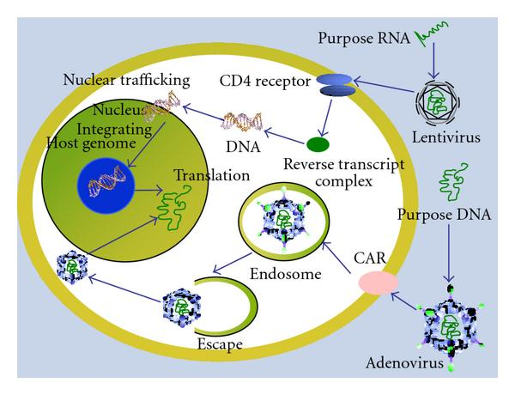
Virally Mediated Transduction
Genetic material carried by a virus
Can be modified
or mostly substituted
By a Synthetic Construct
Capsid can also be modified
Producing the desired specific tropism

Slide 32
Virus Types Pirated for Transfection
Lentiviruses: slow virus
Retroviruses like HIV
Adeno-associated Viruses
Infects humans, but doesn’t cause disease
Adenoviruses – Adenoid infection/tonsillitis
Herpes Simplex Viruses
Genital herpes, cold sores, chicken pox/shingles

Slide 33
Virus Types Pirated for Transfection

Slide 34
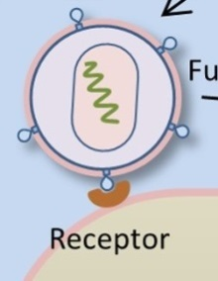
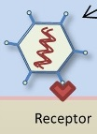
Virus Types Used
All bind receptors
Lentiviruses
Delivers RNA
Adeno-associated Viruses AAV
Single-stranded DNA
Adenoviruses & Herpes Simplex Viruses
Deliver double stranded DNA

Slide 35
Lentiviruses
Able to infect fully differentiated cells
Rely on retrotranscription: RNA→DNA
Reverse transcriptase
Derived from pathogenic agents
Safer vectors substitution of envelope protein
Efficient gene delivery in vivo
Injected intracranially

Slide 36
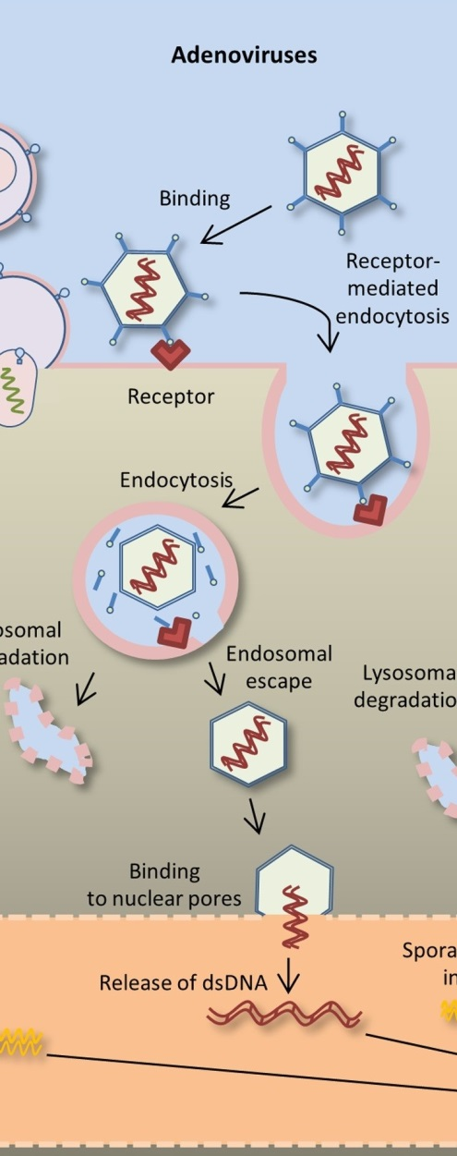
Adenoviruses
Non-integrating naked viruses
Efficiently transfect dividing cells
or non-dividing cells
High virulence
Potent toxicity in the CNS
Helper virus carries some information
To reduce toxicity

Slide 37
AAV Vectors
Never associated with any pathology
most used vector for gene transfection in vivo
Small packing capacity (5 kb)
Increased by clever molecular tricks
Dividing DNA package into 2 AAV vectors
AAV serotypes have distinctive tropism
Neurotropism: AAV_{1, 2, 4, 5, 8, 9}, and AAV_{rh10}

Slide 38
AAV Vectors
Stable infection – may last years
AAV₉ and AAV_{rh10}
transported along axons
Capsid gene shuffling
Generates different cap proteins
Increases tropism flexibility
Some AAVs cross the BBB

Slide 39
Herpes Simplex Vectors
Large genome –thus- large capacity
152 kb – can carry 30kb experimental DNA
High Tropism for CNS
No immunogenic response
May activate during replication
Deleting some HSV DNA → safer
Complex envelope – difficult development

Slide 40
How to make use of viral vectors?
Viral genes must be replaced
At least partly
Substituting a gene package
To accomplish specific experimental goals
The gene transfection cassette
This cassette must contain elements
that regulate and drive expression

Slide 41
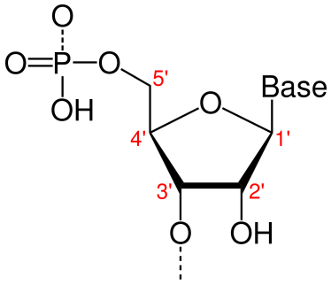
Virally delivered Gene packages
For Coordinated control of gene expression
Manipulating gene expression
Using Transcription Factor regulatory elements
Found in the gene’s promoter
Requires cis-acting elements
in both 5’ and 3’ untranslated region (UTR)
of the expression cassette

Slide 42
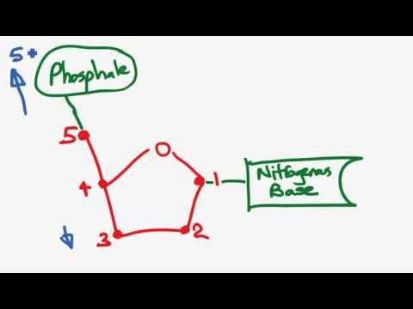
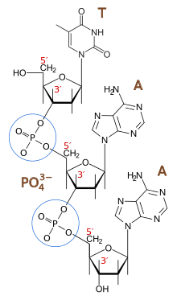
Transfection Gene Cassette
Targeting Neuron Specific Promoters
To promote gene expression in neurons only
Not in glia
Different cassettes could target Glia
5’ UTR cis-regulatory elements:
Core promoter, enhancer, silencers, insulators
Matrix attachment regions, locus control regions

Slide 43
Neural Transfection Cassette
5’ cis-regulatory elements: (upstream of gene)
such as a promoter
are Binding Sites
for trans-acting factors
such as Transcription Factors
Using those found only in neurons
Allows for Neural Transfection Cassettes

Slide 44
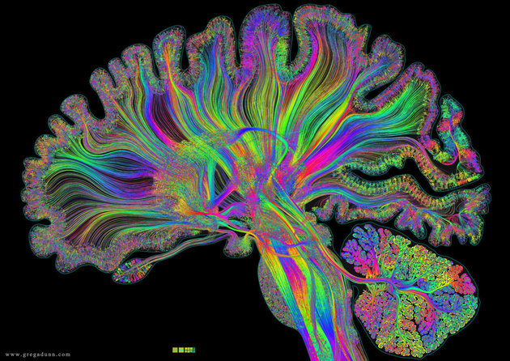
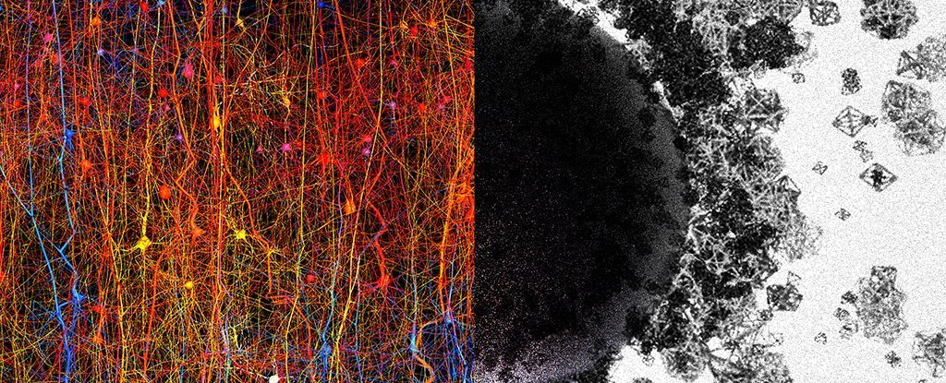
Targeting Specific Neurons
The brain is huge and complex

Slide 45
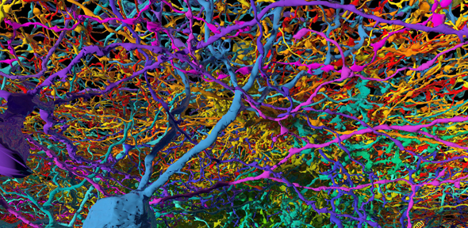
Targeting Specific Neurons
The brain is huge and complex
Every region has specific functions
And specific cell types to accomplish those
Specific neuronal types have specific
Phenotypes
Created by specific proteins

Slide 46
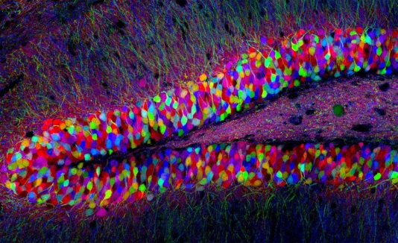
Targeting Specific Neurons
Specific Proteins have unique genes
With unique regulatory systems
Distinctive promoters
Distinctive trans-acting systems to drive them
Therefore, each neural cell type
Can be targeted specifically

Slide 47
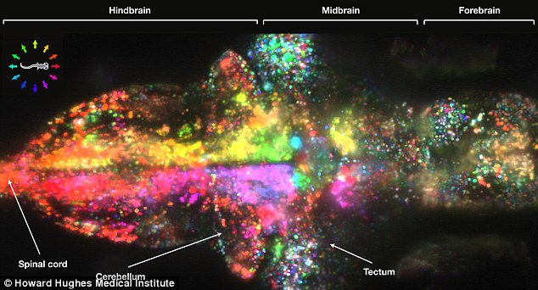
Building a cassette to hit Specific Neurons
Find a promoter for a protein
Uniquely found in those neurons
Or that protein may be the focus of investigation
e.g. Orx₂ receptor in our research
Neuron specific promoters
Do not specify cell types
Neuron specific enolase, synapsin-1, PDGF, TH, DBH

Slide 48
Neuron specific promoters
Neuron specific enolase (NSE)
synapsin-1 (SYN)
Platelet-derived Growth Factor (PDGF)
Tyrosine Hydroxylase (TH –catecholamines)
DA β Hydroxylase (DβH – NE, Epi neurons)
Ca⁺⁺ Calmodulin Kinase (CamK, excitatory)

Slide 49
Building a cassette to hit Specific Neurons
Cell specific promoters may be too large
For viral vectors
Constitutive viral promoters
Drive expression in all cells (CMV)
Smaller hybrid promoters
Efficiently induce strong specific expression

Slide 50
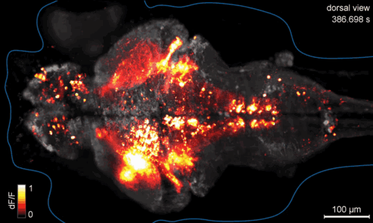
Building a cassette to drive Specific Genes
Specific promoter drives Gene expression
Cassette promoter and gene need not
Come from the same system
This pairing may not promote
Strong expression
Or any expression

Slide 51
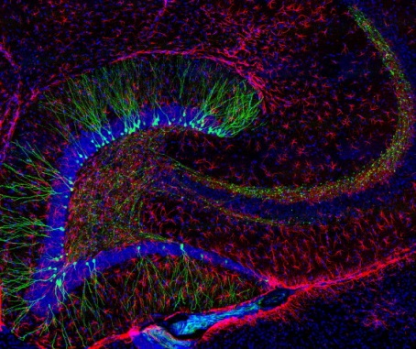
Enhancing Promoter – Gene coupling
Strong expression may require an enhancer
Transcriptional activation
Human cytomegalovirus (CMV)
Immediate-early gene enhancer
Highest activity of all viral enhancers
Inserted 5’ to cellular promoter

Slide 52
Enhancing Promoter – Gene coupling
Woodchuck Hepatitis Virus
Post-transcriptional regulatory element (WPRE)
cis-acting RNA element
Auguments transgene espression
Powerfully increases mRNA accumulation
Most effective inserted 3’ UTR

Slide 53
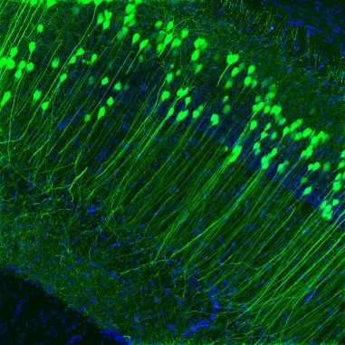
See what you’ve transfected
Add a gene for a fluorescence protein
GFP
YFP
mCherry

Slide 54
What a Cassette might look like
Neuron specific
promoter
Color gene
3’
5’
gene
CMV
SYN
DβH
CREB
GFP
WPRE
Cell type specific
promoter
enhancer
enhancer

